Slide 1


Project name: Compensation for an Analogic Pressure Sensor (CAPS)
Team members:
Erik Cura and Brendan Hon

Slide 2
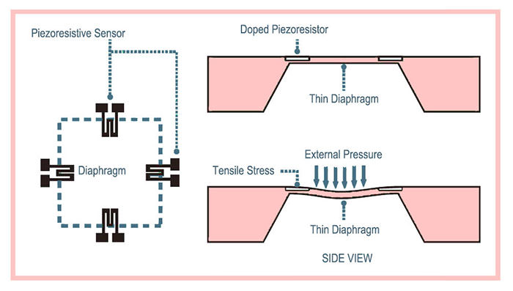
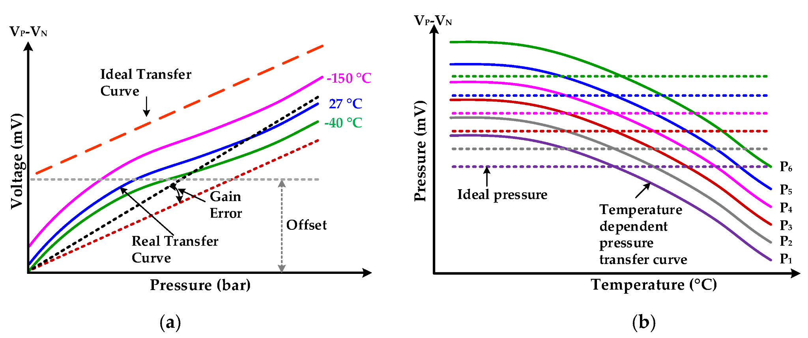
Problem statement
The accuracy, sensitivity, and linearity of piezoresistive MEMS pressure sensors are significantly impacted by temperature variations, presenting challenges in achieving reliable measurements.

Slide 3
Solution Proposal
Our sponsor has tasked us with the research, development, and analysis of a completely analog temperature compensation board for a piezoresistive pressure sensor following two separate strategies.

Slide 4
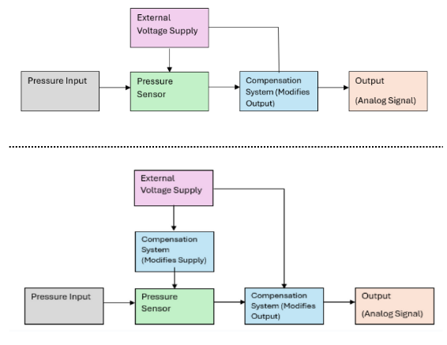
Diagram of subsystems and interface
Erik Cura
Brendan Hon
Notes:
“Simple”, but we are a research project

Slide 5
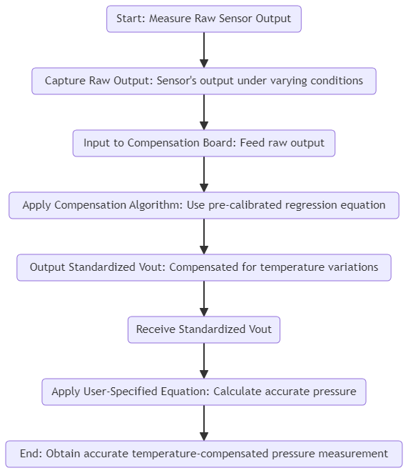
Task partition: Strategy #1
Develop a signal conditioning circuit incorporating a temperature compensation model aimed at modifying the output voltage of the pressure sensor
Strategy Deliverables:
Derivation of a sensor compensation model through the application of statistical and machine learning techniques.
POC board design testing and verified for 1 piezoresistive sensor
Conducting a comparative analysis of Strategy #2, evaluating cost, accuracy, versatility, and implementation feasibility.

Slide 6
Task partition: Strategy #2
Strategy #2: Supply and output voltage manipulation
Output voltage change
Piezoelectric effective resistance
Supply voltage response
Strategy Deliverables:
Development of optimal behavior and model
Design optimized for versatility and accuracy
Working prototype PCB board for single sensor

Slide 7
Subsystem progress in past 1.5 months
Subsystem #1:
Statistical models and strategies were used to create preliminary regression equation
Feasibility testing through implementation of regression model in SPICE
Parts Analysis
Presentation and approval of solution to the sponsor
Subsystem #2:
Creation of preliminary regression equation
Research on how to implement input voltage manipulation

Slide 8
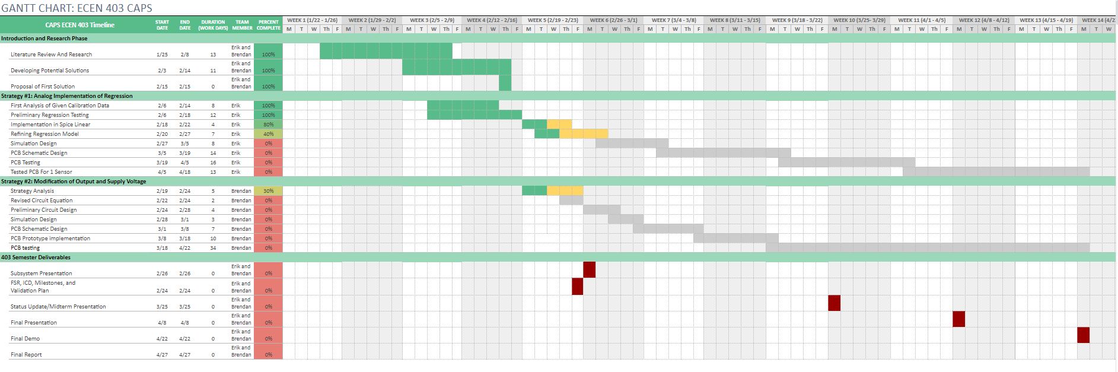
Execution plan

Slide 9
Validation plan
Task | Specification | Result | Owner
Output Signal Limit | 0-150mV |  | All
Maximum Area | Area Shall not Exceed 10mm by 50m |  | All
Prediction Accuracy | <2% error |  | All
Resistance Operating Range | Board to remain functional for 6000 to 9000 ohms |  | All
Input Voltage | The input voltage for the CAPS board shall be 5V |  | All
Thermal Operation Range | System should be able to operate from 20C to 100C |  | All

